Slide 1
PashuCare AI
AI-Powered Livestock Health Intelligence Platform for Pakistan
University
Riphah International University Lahore
Department
Riphah School of Computing & Innovation
Supervisor
Ms. Uzma Kiran (Lecturer)
Program
BSSE | Final Year Project | 2026
Presented by: Gulraiz Liaqat (50759) | Awais Shabbir (51460) | Wahib Ali (45438)

Slide 2
Project Team
Gulraiz Liaqat
Awais Shabbir
Wahib Ali
ID
50759
ID
51460
ID
45438
Program
BSSE
Program
BSSE
Program
BSSE
Role
Team Lead & AI
Role
Backend & Cloud
Role
Frontend & DB
Email
Rgulraiz696@gmail.com
Email
awaiskamboh0810@gmail.com
Email
Wahibchoudry78@gmail.com
Project Supervisor: Ms. Uzma Kiran — Lecturer | Riphah School of Computing & Innovation

Slide 3
Table of Contents
01
06
Introduction
Project Scope
02
07
Competitive Analysis
System Architecture
03
08
Problem Statement
Tools & Techniques
04
09
Proposed Solution
Project Plan (WBS & Gantt)
05
SDG Mapping

Slide 4
Introduction
60%
8M
200M+
1:15K
of Pakistan's Agricultural
GDP comes from livestock
people directly employed
in the livestock sector
cows, buffaloes,
goats, sheep
vet-to-animal ratio
in rural Pakistan
🐄 About PashuCare AI
⚠️ Why Pakistan Needs It Now
✅ Our Solution
PashuCare AI is a full-stack, AI platform built specifically for Pakistan's rural farmers. A farmer takes a photo of their animal on smart phone PashuCare AI instantly detects diseases, estimates body condition, and sends the result with recommended treatment.
Pakistan has 200M+ animals but only 1 vet per 15,000 animals in rural areas. Diseases like Foot & Mouth Disease (FMD), Lumpy Skin Disease (LSD), and Mastitis .Detection is still done by manually no AI tool exists for Pakistani rural farmers. Delay cause animal deaths and income loss.
PashuCare AI works like a digital doctor for animals available 24/7, works in Urdu & Punjabi, requires only a photo. It detects disease, scores body condition, predicts heat stress, connects to vets online, maintains health records, and lets farmers order medicines , all from one app

Slide 5
Existing Systems & Competitive Analysis
Why existing solutions fail
Feature | Maveshi | Nizi Solutions | Kissanai | PashuCare AI ✓
AI Image-Based Disease Detection | ✗ | ✗ | ✗ | ✓
Body Condition Scoring (BCS) | ✗ | ✗ | ✗ | ✓
Heat Stress Prediction | ✗ | ✗ | ✗ | ✓
Vet Telemedicine Dashboard | Minimal | Minimal | Limited | ✓ Full
AI Chatbot (Urdu/Punjabi) | ✗ | ✗ | ✗ | ✓
In-App Medicine Marketplace | Stock only | Enterprise | ✗ | ✓ In-app
Community Forum | ✗ | ✗ | ✗ | ✓
Low-End Device Support | ✗ | ✗ | ✗ | ✓
Target Audience | Small farms | Large enterprise | Tech farmers | Rural farmers ,farms

Slide 6
Problem Statement
01
🕐 Late Disease Detection
02
📋 No Digital Health Records
03
🏥 Veterinary Unavailability
Diseases detect too late — manual observation with no AI tools
No digital history for animals; farmers can't track past treatments or vaccinations.
Estimate 1 vet per 15,000 animals in rural Pakistan ,critical delays cost lives and money.
04
💸 Huge Economic Losses
05
🔄 No Routine Health Checkups
06
🤖 Zero AI Solutions for Pakistan
Reduced milk yield, higher treatment costs, and increase death rate.
No tools for regular monitoring ,problems only found when symptoms are severe.
Zero AI-powered livestock health products and disease Detection

Slide 7
Proposed Solution – PashuCare AI
AI Disease Detection
Body Condition Scoring
Heat Stress Prediction
01
CNN-based vision (ResNet50, MobileNetV2) detects skin infections, swellings, eye discharge from photos. 85%+ accuracy target.
02
Automated assessment of livestock body condition from lateral images — nutritional status & weight estimation without manual weighing.
03
Predicts risk using real-time weather data (THI index), breed type & historical patterns. Issues 24–48 hour advance alerts.
Digital Health Records
Vet Telemedicine Dashboard
Medicine Marketplace
04
Structured per-animal records: disease history, vaccinations, BCS trends & breeding. Smart vaccination reminders via SMS/push.
05
Veterinarians remotely review AI diagnoses, view health records, conduct video/chat consultations & issue prescriptions.
06
In-app ordering with JazzCash/Easypaisa payment. Integrated vet prescription workflow. No middlemen — direct to farmers.
AI Chatbot (Urdu/Punjabi)
Community Forum
Analytics Dashboard
07
NLP-powered conversational chatbot supporting Urdu & Punjabi — removes literacy & language barrier for rural farmers.
08
Peer-to-peer knowledge sharing, regional outbreak alerts & expert vet responses.
09
Real-time disease heatmaps, vaccination coverage & outbreak trends for NGOs & government to support national policy.

Slide 8
SDG Mapping
SDG 1
SDG 3
SDG 9
SDG 2
No Poverty
Good Health & Well-being
Industry & Innovation
Zero Hunger
Healthier livestock means better milk & meat yields directly improving food security.
Prevents disease spread, promotes healthier animals and safer communities.
Applies AI and mobile tech to modernize Pakistan's agricultural sector.

Slide 9
Project Scope
👥 Target Users
⚙️ Functional Scope
Small & medium rural farmers across Pakistan
Dairy farm owners and managers
Veterinary professionals and clinics
Government agriculture departments
AI disease detection from animal photos
Body Condition Scoring from lateral images
Heat stress prediction (24–48 hrs in advance)
Digital per-animal health records & vaccination reminders
Vet telemedicine consultation (video/chat)
In-app medicine ordering (JazzCash/Easypaisa)
AI chatbot in Urdu & Punjabi
Community forum with vet-moderated Q&A
🔧 Technical Scope
💼 Business Scope
Android mobile app (React Native) — low-end device support
React.js web dashboards (vet & admin)
AI: CNN, ResNet50, MobileNetV2,
Backend: Node.js / Django REST APIs
Database: MongoDB (records) + PostgreSQL (transactions)
Cloud: AWS / Azure ,scalable deployment
Notification alerts
Subscription model for farmers (monthly/yearly)
Enterprise licensing for dairy farms
Commission from medicine marketplace orders
Future: IoT smart collars, milk yield prediction, insurance integration

Slide 10
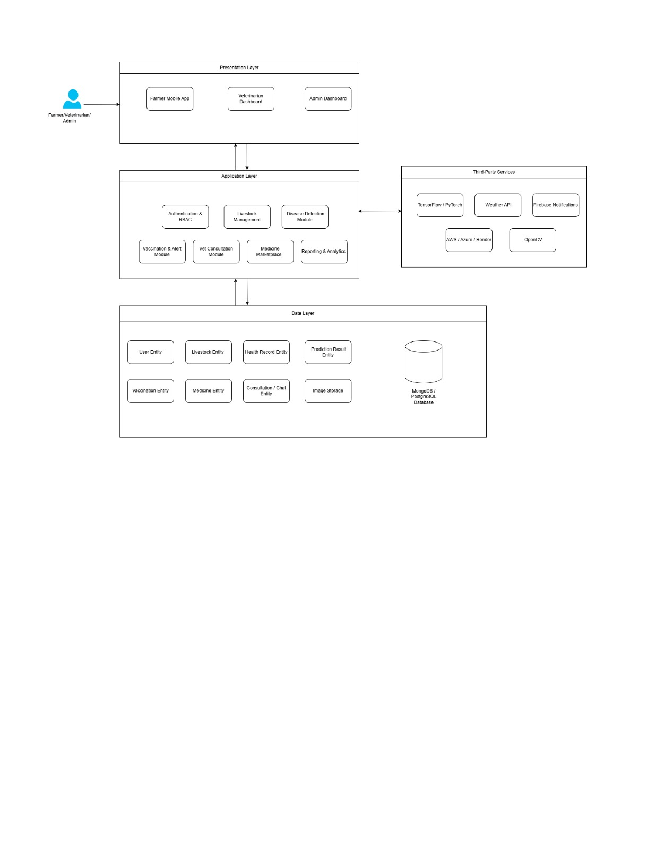
System Architectural Design

Slide 11
Implementation Tools & Techniques
Frontend
Backend
AI & Image Processing
Database & Cloud
React Native for Farmer mobile app
React.js for Vet & Admin web dashboards
Figma for UI/UX prototyping
Node.js / REST API for development
JWT for Authentication & authorization
Draw.io for UML & system modeling
TensorFlow / PyTorch for ML model training
CNN, ResNet50, MobileNetV2 for Disease detection
OpenCV for Image preprocessing
Hugging Face mBERT for AI Chatbot (Urdu/Punjabi)
MongoDB / PostgreSQL for Health & user records
AWS S3 / Azure Blob for Image storage
Firebase FCM for Push notifications
JazzCash & Easypaisa for Payments
Methodology: Agile Scrum | Modular Design | Cloud Deployment | GitHub Actions

Slide 12
Project Plan – Work Breakdown Structure (WBS)
1. Project Management
2. Documentation (SRS)
3. System Development
4. Testing
5. Final Submission
Proposal & WBS planning
Requirements analysis
Backend APIs & DB design
Unit & integration testing
Final report writing
Project planning & scheduling
UML diagrams (Use Case, Class, ER, Sequence)
Farmer mobile app (React Native)
Performance & load testing
GUI finalization
Weekly team meetings
Literature review & survey
Vet & Admin dashboards (React.js)
Security audit (JWT, SQL injection)
User guide & admin documentation
Risk & change management
SRS draft & final submission
AI model training & cloud deployment
Bug fixing & UI polish
Presentation preparation

Slide 13
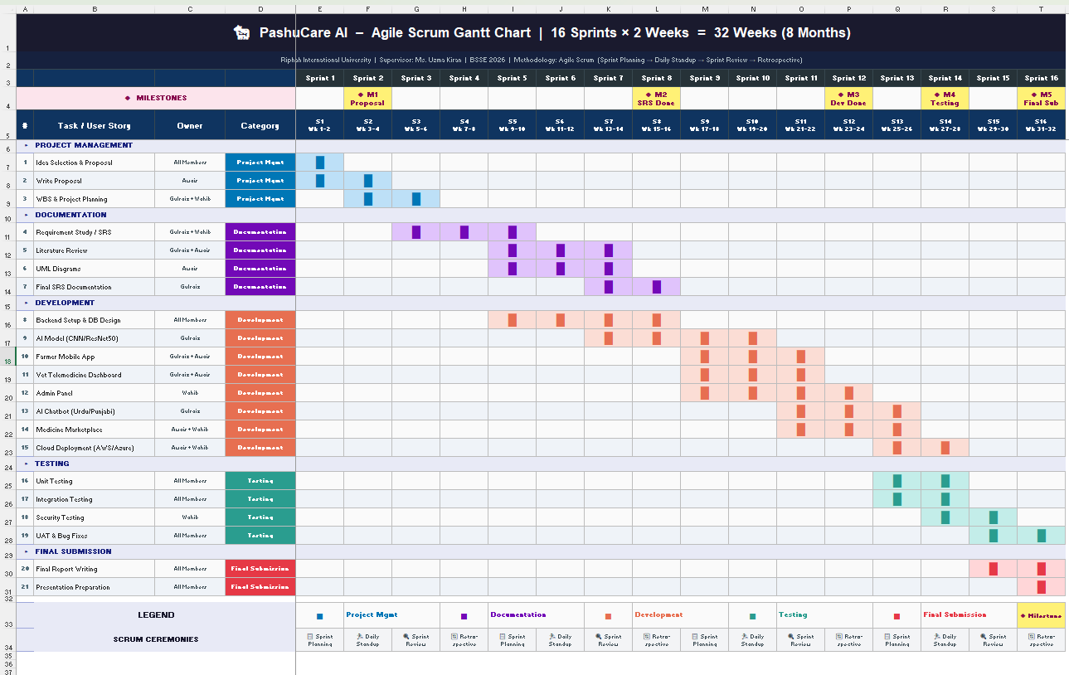
Project Plan – Gantt Chart (8 Months / Agile Scrum)
Proposal Defense
SRS Complete
System Built
Final Defense

Slide 14
Thank You!
PashuCare AI — A Digital Doctor for Pakistan's Livestock
Gulraiz Liaqat
Awais Shabbir
Wahib Ali
ID: 50759
ID: 51460
ID: 45438
Team Lead & AI Developer
Backend & Cloud Engineer
Frontend & DB Engineer
Rgulraiz696@gmail.com
Awaiskamboh0810@gmail.com
Wahibchoudry78@gmail.com
BSSE | Riphah University Lahore
BSSE | Riphah University Lahore
BSSE | Riphah University Lahore
2025
2025
2025
Supervisor: Ms. Uzma Kiran (Lecturer) | Questions & Discussion — We welcome your feedback!
Riphah School of Computing & Innovation | BSSE | 2025

